Slide 1
Starting a Venture Company & Startup Financial Planning
Steve Artim – Entrepreneur
Date: 1/12/2023

Slide 2

Covered Material
Overview of VC funds in the U.S. and Silicon Valley
Why does a startup try to get VC funds
Stages in VC investing
What steps you take to get VC capital
How to write a financial section of a Business Plan

Slide 3
Qualifications
Experience
Raised over $40 million dollars over my career
Mitsubishi Electric – Real Time Visualization (RTVIZ) – Corporate Funding – Pioneered real time volumetric rendering and visualization
InnoPath - Angel and Traditional Venture – Pioneered Mobile Device Management
ephone – Angel – Pioneered text data services and mobile search
WirelessWerx – Angel and Traditional Venture – Pioneered mobile indoor location and services
FeverCoach Inc – Angel – Pioneer in mobile App FLU and Covid diagnosis
I have pitched 100’s of VC’s from Silicon Valley, Tokyo, Paris and London
Notes:
Spent carrier after working in Fortune 500 and Fourtune 1000 companies in startups
I pitched all the Sand Hill road old VC’s and VC’s in New York, Boston, Japan, and Paris
Tier 1’s to barely Tier 3’s
Band of Angels and Angel pitch forums
I have also received Corporate venture funds

Slide 4
Venture capital (VC) is a type of private equity a form of financing that is provided by firms or funds to small, early-stage, emerging firms that are deemed to have high growth potential, or which have demonstrated high growth
Wikipedia
Notes:
Early Stage of Stages – Most firms like to invest enough over multiple stages
High Growth is critical – Disruptive technologies in high growth

Slide 5
Venture Capital Resets
-34% Quarter over Quarter drop in all Funding to $74B
Deal activity hit 7,936 deals total, marking a 9.5% quarterly drop and a 7-quarter low.
Q3’22 saw only 25 new unicorns (private companies valued at $1B+)—the lowest unicorn birth count since Q1’20.
US stock markets are down 40% for the year and zero options for IPO and exits

Slide 6
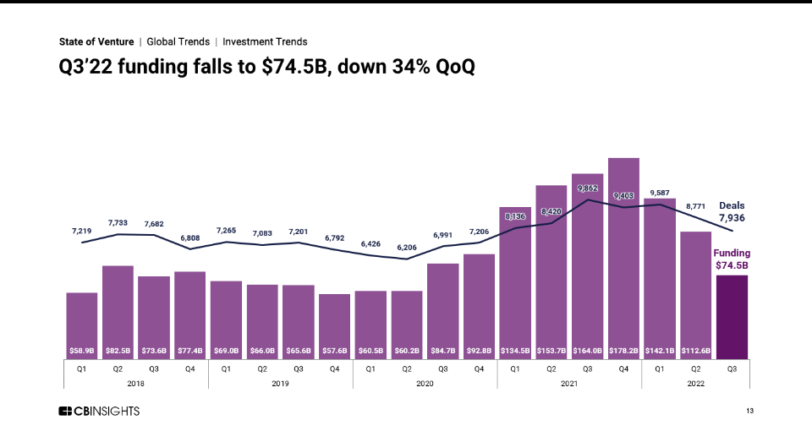
2022 Numbers
Notes:
US venture investments in 2018 hit just shy of $100B
There are more than a 1000 venture firms now, It seems everyone is in venture
This is approaching 2000 and Dot Com numbers
My VC friends are complaining about the high valuations my startup friends feel that the valuations are valid

Slide 7
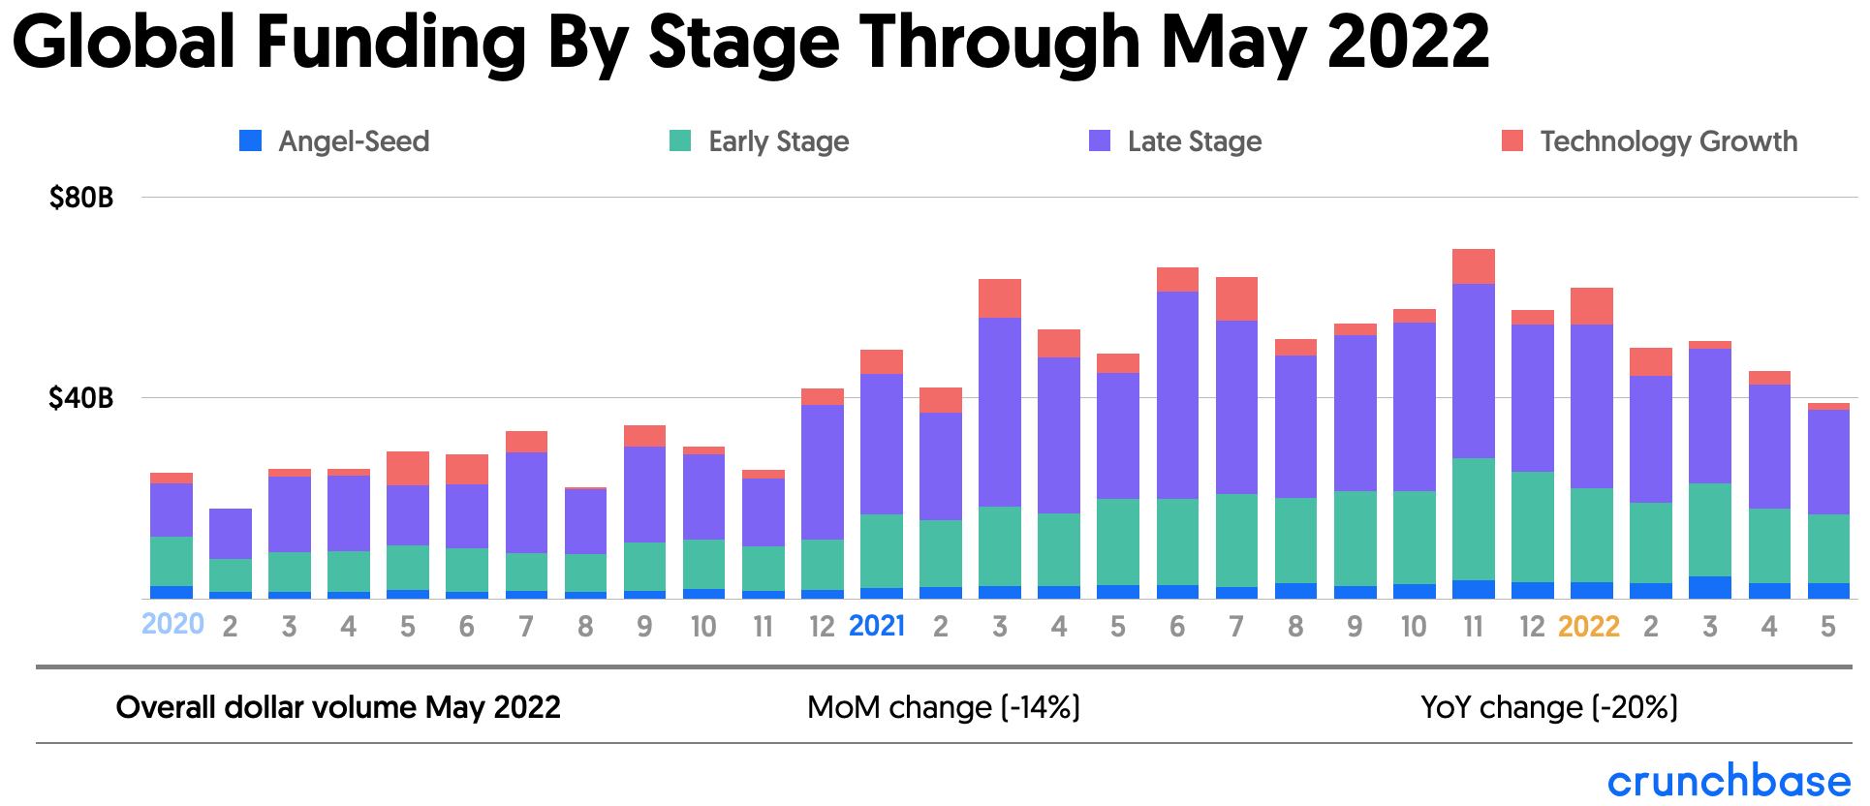
All Stages of Funding Drop
Notes:
Average Deal size is $18 M. That is huge
Almost the same level but a lot fewer deals.
Valuations are way up
So much venture from all over is pushing up prices

Slide 8
2023 will be a rough ride
There remains a high level of “Dry Powder” after years of record fundraising by VC’s
This capital will help support seed and early-stage investment, but it is not likely to come to the rescue of highly valued, late-stage companies
Late-stage companies have seen a enormous decline on available capital and are experiencing a huge decline in stock values
I am predicting a “Dinosaur Extinction Event” just like in 1999 DOT. Com Bubble burst

Slide 9
Hot Areas in 2023
Cybersecurity – Everyone working from home has caused a problem area to get worse
Supply Chain Logistics and Globalization – Supply chains are shifting from a dependance on China and transportation platforms are getting smarter
CleanTech and Green Sustainability – Government will likely incentivize and regulate change to clean energy solutions
Productivity and Collaboration – Teams are going back to the office but are now spread all over the world

Slide 10
“It is always better to spend other people's money!”
Entrepreneur’s Guiding Principal

Slide 11
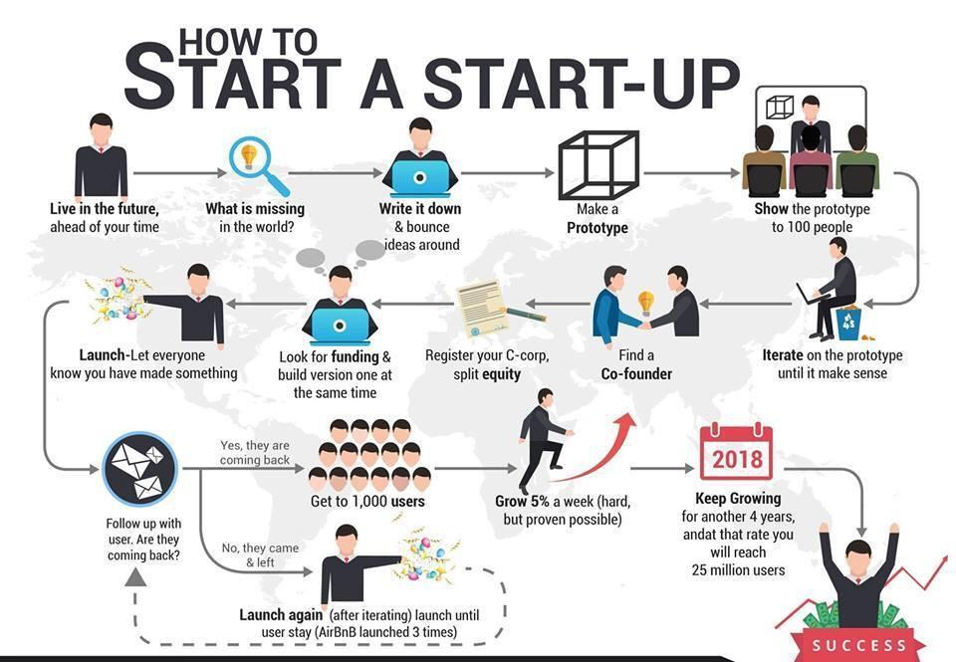
Seed Funding
Why raise money?
2025
Series A Growth Funding
Notes:
Seed Funding – you probably need some prototype money. Servers, components, Amazon Web services all cost money
Typically from Angels or Friends and Family
There are lots of people and networks to build so you will be spending travel time
This is usually done as a note to transfer into Series A shares
Series A - Your first venture round. You need to be prepared and realistic on how much money you need to get to the next major milestones that will drive valuation
This could take you 6 – 9 months
This takes a lot of time - Many many meetings
You have to be prepared

Slide 12
Investment Stages Rules of Thumb
Investment | Valuation | Founder Dilution
Seed | 1,000,000 | 10%
Angels | 5,000,000 | 20%
Series A | 10,000,000 | 30%
Series B | 20,000,000 | 40%
Series C | 50,000,000 | 50%
Series D | 100,000,000 | 60%
Later | 200,000,000 | 80%
Exit | 500,000,000 | 90%
Notes:
These may be low today but they are not that far off
These valuations directly drive how much money you can raise without having too much dillutions. Will talk about this later in and exercise.

Slide 13
Business Needs Capital
How to Go Raise Some Capital!
Angels (Must have $1M in liquid assets by law)
Band of Angels (Many groups, lots of Virtual Meet Ups and competitions) Indian Angels, Chinese Angels
Rich Individual (Lots of them in Silicon Valley)
Venture (Early Stage)
Do your due diligence on what venture firms can fund you
They all will take a meeting to learn but if they don’t know the space you are wasting your time
You can’t divorce your VC
Non-Traditional – Hedge Funds, Venture Banks, Aggregators, etc.
Corporate
If you want to be acquired this is perfect, may not be a triple or home run but could be a solid single or double.
Notes:
SEC Rules: Individual must have $1M assets
There are Angle meet ups – and code competitions
As for VC firms. Get on their websites and see who and what they are investing in.
If you are in their sweet spot give them a call. They will take a meeting to pitch. As I said they will always take a meeting
It is up to you to pick the right ones so you don’t waist your time.
Corporate investment may take longer to setup. You need to know something about where there products are going or some need they have. Google and Facebook do a lot of this today. Cisco was famous for doing it not so long ago. Also Microsoft is a big corporate investor so is Intel.

Slide 14
VC Firms
There are about 1,000 VC’s in the US
They range from Boutique to Major Old Silicon Valley Players (Accel Ventures, Kleiner Perkins, etc.)
Boston and New York both have large VC firms
Most of the old VC firms funds are so large now they do very little early stage investing, Although Series A valuations are so high they are starting to get back in.
Angel and Small VC’s are doing most of the early stage work, now there are many financial companies trying to get into venture. Many non-traditional players.
Find the VC that is right for your company
Expertise in your product
Connections that help your company
Customer relations

Slide 15
The Process
Reach out for a first meeting, There are many virtual events today going on.
Try to get a referral from your network first
If you can’t get one reach out to a Partner at the Firm
Meeting 1 – Will probably be with Associate, and Maybe a VP
Meeting 2 (If they like you) – Will be with 1 or more Partners
Meeting 3 (If they really like you) – Will be with All the Partners
If that goes well you will go into Due Diligence round
If that goes well you will get a Term Sheet
This will spell out the terms and the valuation at which they will participate
The Lead VC will set these terms, you will get other VC to Follow and join the round as well
Start early, this process can take as little as 2 months and as long as 8 months. First meeting to funding. As I stated earlier. It is getting harder to close.

Slide 16
Terms to Watch For
Valuation
This goes hand in hand with how much capital you raise.
BOD participation
Every round will likely add 1 to 2 seats on the BOD
Added Benefits like Warrants
These are deal sweetners. Compounded interest is another.
Voting Preferences
Large VC’s usually like veto vote authority
Milestone kickers
These can be positive or negative for the entrepreneur. Be wary development always takes longer than expected.
Liquidation Preferences
Venture will always ask to sell before the entrepreneur. There is usually some lock outs for Founders.

Slide 17
Financial Files Needed
Income Statement
Simply all your income (First years probably $0) vs your expenses
Balance Sheet
Your Assets vs your Liabilities, includes Shareholder equity and contributed capital
Statement of Cash Flows
Spreadsheet of your cash on hand and your cash expenditures.
CASH IS KING - You have to know all its uses
Cap Table
Spreadsheet of all the owners of your companies shares
These include – Founding Stock, Incentive Stock Options and Employee Stock Option Pool

Slide 18
Cap Table Exercise Founding
This is a real company in NFT Space – Non-Fungible Token
Owners | # Stock | Price | Valuation | % Ownership
Founder 1 | 1,000 | $1 | $1,000 | 50%
Founder 2 | 1,000 | $1 | $1,000 | 50%
Employees
SEED
VC Series A
Founded - 2018

Slide 19
Cap Table Exercise Employees
Owners | # Stock | Price | Valuation | % Ownership
Founder 1 | 1,000 | $1 | $1,000 | 45%
Founder 2 | 1,000 | $1 | $1,000 | 45%
Employees (10%) | 200 | $1 | $200 | 10%
Seed
VC Series A

Slide 20
Cap Table Exercise Seed Round
Owners | # Stock | Price | Valuation | % Ownership
Founder 1 | 1,000 | $1 | $8.3 M | 41%
Founder 2 | 1,000 | $1 | $8.3 M | 41%
Employees | 200 | $1 | $182K | 8%
Seed | 120 | $8,333.33 | $1 M | 10%
VC Series A
$10 million dollar valuation and they want to invest $1 M in early 2018

Slide 21
Cap Table Exercise Series A - VC
Owners | # Stock | Price | Valuation | % Ownership
Founder 1 | 1,000 | $1 | $21.54 M | 22.9%
Founder 2 | 1,000 | $1 | $21.55 M | 22.9%
Employees | 200 | $1 | $ 4.3 M | 4.5%
Seed | 120 | $8,333.33 | $ 2.58M | 2.7%
VC Series A | 2,088 | $21,551.72 | $45 M | 47%
$50 million dollar valuation and they want to invest $45 million in 2019

Slide 22
Cap Table Exercise Series B - VC
Owners | # Stock | Price | Valuation | % Ownership
Founder 1 | 1,000 | $1 | $34 M | 17.8%
Founder 2 | 1,000 | $1 | $34 M | 17.8%
Employees | 200 | $1 | $ 6.8 M | 3%
Seed | 120 | $8,333.33 | $4.3 M | 1.8%
VC Series A | 2,088 | $21,551.72 | $71 M | 33%
Series B | 1,910 | $34,029 | $65 M | 30%
$150 million dollar valuation and they want to invest $65 million in July 2021

Slide 23
Cap Table Exercise Series C - VC
Owners | # Stock | Price | Valuation | % Ownership
Founder 1 | 1,000 | $1 | $186.7 M | 14%
Founder 2 | 1,000 | $1 | $186,7 M | 14%
Employees | 200 | $1 | $ 37.2 M | 2.8%
Seed | 120 | $8,333.33 | $22.4 M | 1.6%
VC Series A | 2,088 | $21,551.72 | $389.9 M | 29.3%
Series B | 1,910 | $34,029 | $356.7 M | 26.8%
Series C | 803 | $186,767 | $150 M | 11.2%
$1.18 Billion dollar valuation and they want to invest $150 million in November 2021. (Just 5 months)

Slide 24

Dream Big and Change the World

